Slide 1




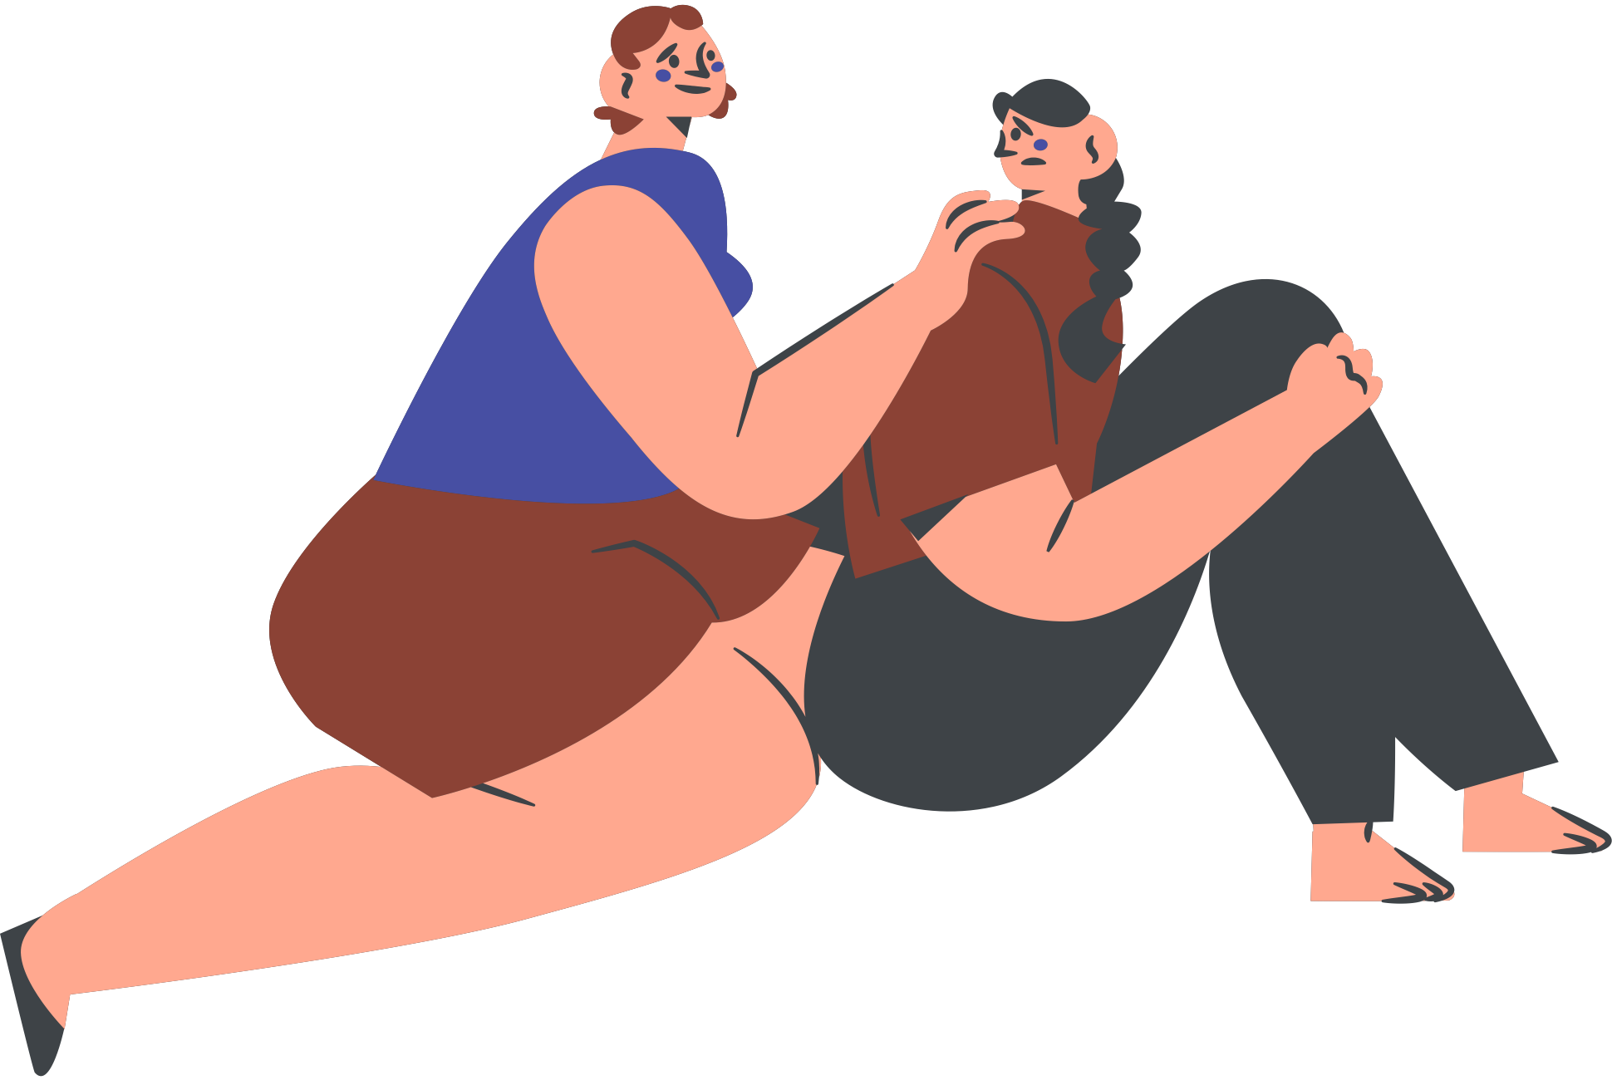
The Effects of Social Media on Mental Health

Slide 2
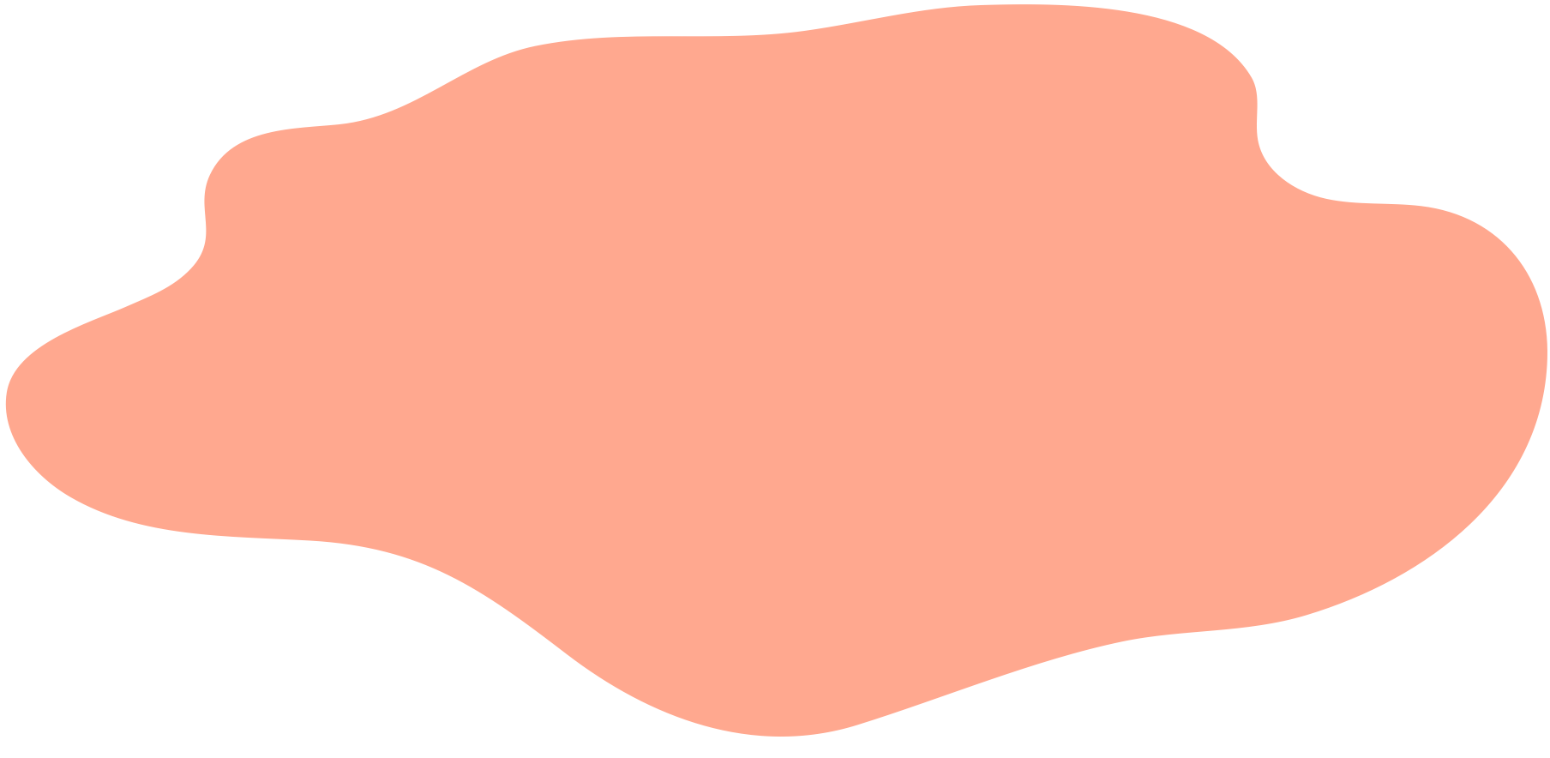



INTRODUCTION
  In today's digital age, social media has become an integral part of daily life, alongside its pervasive presence, concerns have arisen regarding its impact on mental health (Bossard, 2020).
  Studies have explored the complex relationship between social media use and psychological well-being, highlighting both positive and negative effects (Karim et al., 2020).
  This presentation aims to delve into the existing literature to provide a comprehensive understanding of how social media affects mental health.

Slide 3
INFLUENCE OF SOCIAL MEDIA ON SELF ESTEEM
  Research indicates a significant correlation between social media use and self-esteem issues. According to a study by Bossard (2020), exposure to idealized images and lifestyles on social media platforms can lead to increased body dissatisfaction and decreased self-esteem, particularly among adolescents and young adults.
  Furthermore, a meta-analysis by Karim et al. (2020) found a consistent negative relationship between time spent on social media and self-esteem levels, suggesting that frequent comparison with others' highlight reels may contribute to feelings of inadequacy.

Slide 4
LINK BETWEEN SOCIAL MEDIA AND LONILINESS
  The advent of social media has transformed interpersonal connections, yet paradoxically, it has also been associated with increased feelings of loneliness and social isolation.
  A longitudinal study by Khalaf (2023) revealed a bidirectional relationship between social media use and feelings of loneliness among young adults, suggesting that excessive engagement may exacerbate existing loneliness or lead to its onset.
  Research by Viner et al. (2019) found that passive consumption of social media content, such as scrolling through news feeds without actively engaging, was particularly associated with feelings of loneliness.

Slide 5

SOCIAL MEDIA AND ANXIETY
  The constant connectivity of social media has been linked to heightened levels of anxiety among users.
  Strickland (2014) study demonstrated that individuals who frequently checked their social media accounts experienced greater anxiety and stress compared to less frequent users.
  Additionally, the fear of missing out (FOMO) prevalent in social media culture has been identified as a significant predictor of anxiety and depressive symptoms (Zsila & Reyes, 2023).

Slide 6

Social Media, Depression, and Mood Regulation
  Research suggests a complex interplay between social media use and depressive symptoms.
  A systematic review by Koehler and Parrell (2020) revealed a significant increase in depressive symptoms among adolescents and young adults coinciding with the rise of social media use.
  Furthermore, exposure to curated and idealized representations of others' lives on social media platforms may contribute to feelings of inadequacy and depression (Karim et al., 2020).
  However, social media also serves as a tool for mood regulation, with individuals utilizing platforms for emotional expression and seeking social support during times of distress (Pantic, 2014).

Slide 7
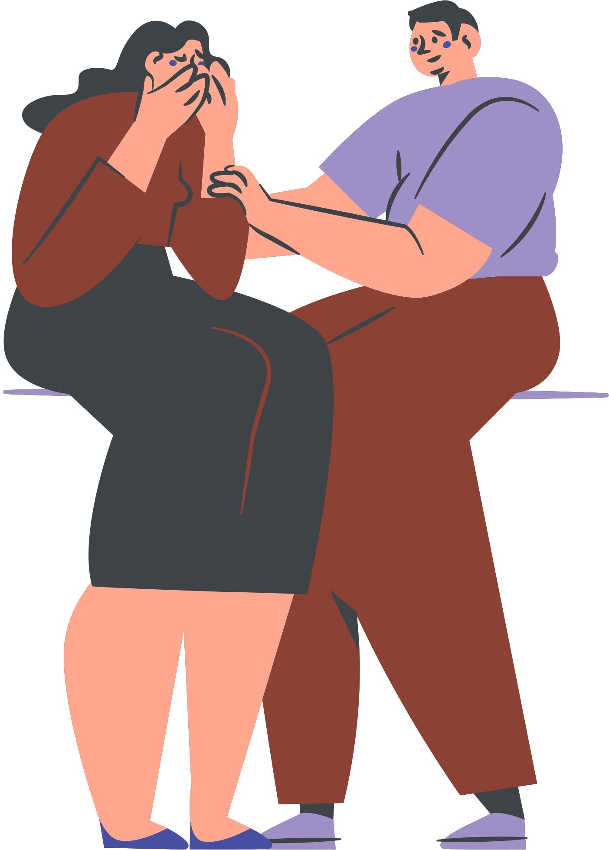
Cyberbullying and Its Psychological Effects
  The anonymity and accessibility of social media platforms have facilitated the proliferation of cyberbullying, posing significant risks to mental health.
  Research indicates that individuals who experience cyberbullying are more likely to report symptoms of depression, anxiety, and low self-esteem (Zsila & Reyes, 2023).
  Moreover, the pervasive nature of cyberbullying can lead to feelings of powerlessness and social exclusion, exacerbating its psychological impact (Viner et al., 2019).

Slide 8

Coping Strategies and Positive Use of Social Media
  Despite potential negative effects, research suggests individuals can employ coping strategies to mitigate social media's impact on mental health.
  Engaging in active social media use, such as participating in online communities or meaningful interactions, has been associated with greater psychological well-being (Strickland, 2014).
  Additionally, fostering a healthy relationship with social media through self-regulation and digital detoxification can promote mental well-being and reduce feelings of anxiety and stress (Bossard, 2020).

Slide 9
CONCLUSION
  In conclusion, the effects of social media on mental health are multifaceted and complex, influenced by various factors including individual differences, usage patterns, and content exposure. While social media offers opportunities for social connection and support, it also presents risks to psychological well-being, including diminished self-esteem, increased loneliness, heightened anxiety, and exposure to cyberbullying. Recognizing these potential risks, individuals need to adopt mindful and balanced approaches to social media use, incorporating coping strategies and self-regulation techniques to promote mental health and well-being in the digital age.

Slide 10
References
Berryman, C., Ferguson, C. J., & Negy, C. (2018). Social Media Use and Mental Health among Young Adults. Psychiatric Quarterly, 89(2), 307–314. https://doi.org/10.1007/s11126-017-9535-6
Bossard, G. (2020). The Effects of Social Media on Mental Health: A Proposed Study The Effects of Social Media on Mental Health: A Proposed Study. https://digitalcommons.bard.edu/cgi/viewcontent.cgi?article=1028&context=senproj_f2020
Karim, F., Oyewande, A., Abdalla, L., Ehsanullah, R., & Khan, S. (2020). Social Media Use and Its Connection to Mental Health: A Systematic Review. Cureus, 12(6). https://doi.org/10.7759/cureus.8627
Khalaf, A. M. (2023). The Impact of Social Media on the Mental Health of Adolescents and Young Adults: a Systematic Review. Cureus, 15(8). https://doi.org/10.7759/cureus.42990
Koehler, S., & Parrell, B. (2020). THE IMPACT OF SOCIAL MEDIA ON MENTAL HEALTH: A MIXED- THE IMPACT OF SOCIAL MEDIA ON MENTAL HEALTH: A MIXED- METHODS RESEARCH OF SERVICE PROVIDERS’ AWARENESS METHODS RESEARCH OF SERVICE PROVIDERS’ AWARENESS. https://scholarworks.lib.csusb.edu/cgi/viewcontent.cgi?article=2131&context=etd
Pantic, I. (2014). Online social networking and mental health. Cyberpsychology, Behavior, and Social Networking, 17(10), 652–657. https://doi.org/10.1089/cyber.2014.0070
Strickland, A. (2014). Exploring the Effects of Social Media Use on the Mental Health of Young Adults. https://stars.library.ucf.edu/cgi/viewcontent.cgi?article=2683&context=honorstheses1990-2015
Viner, R. M., Aswathikutty-Gireesh, A., Stiglic, N., Hudson, L. D., Goddings, A.-L., Ward, J. L., & Nicholls, D. E. (2019). Roles of cyberbullying, sleep, and physical activity in mediating the effects of social media use on mental health and wellbeing among young people in England: a secondary analysis of longitudinal data. The Lancet Child & Adolescent Health, 3(10), 685–696. https://doi.org/10.1016/s2352-4642(19)30186-5
Zsila, Á., & Reyes, M. E. S. (2023). Pros & cons: Impacts of Social Media on Mental Health. BMC Psychology, 11(1). https://doi.org/10.1186/s40359-023-01243-x

